Slide 1
CSCI 580 Final Project
Austin Kleinecke, Daniel Lopez, Andrew Roda

Slide 2
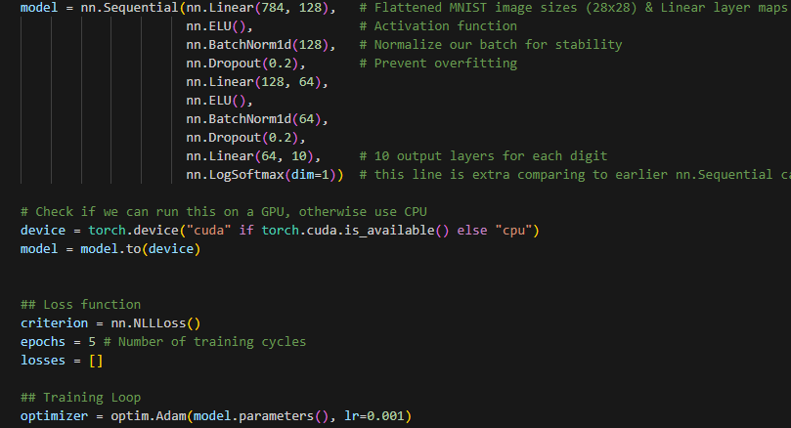
Preparing our model

Slide 3
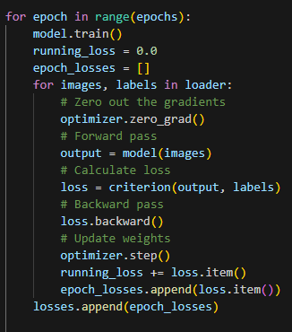
Training Loop

Slide 4
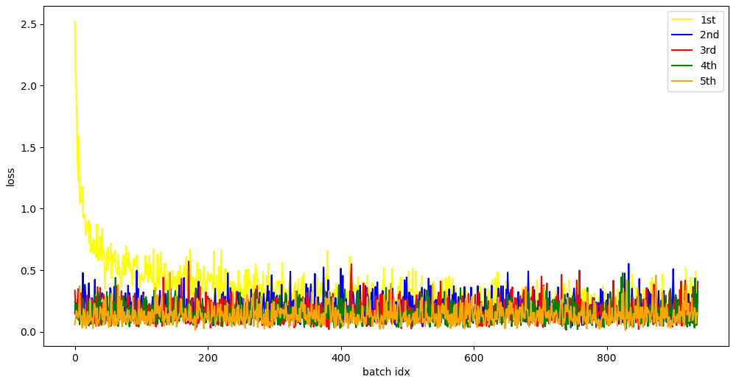

MNIST Training Results

Slide 5
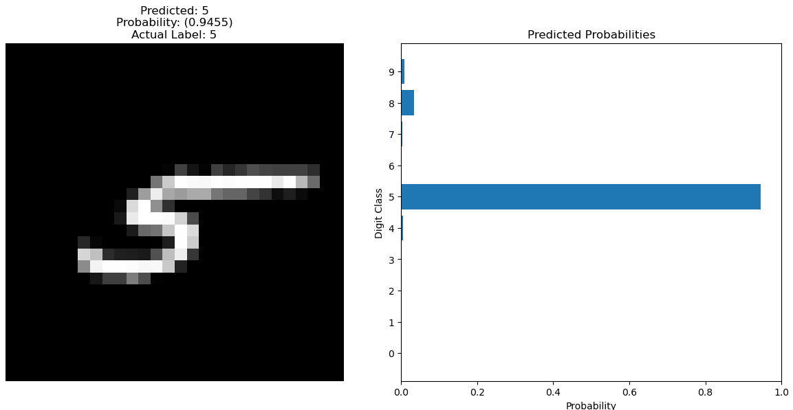

Slide 6
Preparing the class dataset
We loaded the images using the Pillow library
Then, we converted the images into an array of numpy arrays and got the labels from the file name.
We also made sure to resize each image incase it wasn't 28x28
We then saved the images and the labels into idx3 and idx1 respectively
same format used by the MNIST dataset
We then loaded the arrays into a pytorch DataLoader to use with our model

Slide 7
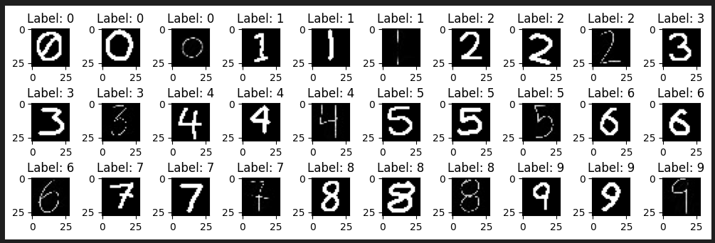
Images and Labels from IDX3/IDX1 in matplotlib

Slide 8
Running on the class dataset
Using the model trained on the MNIST dataset we then ran a forward-only run on the class dataset to see how well the MNIST trained model would do on our class digit images.
after getting the initial loss, we then further trained using the class dataset to see if we could improve the accuracy

Slide 9
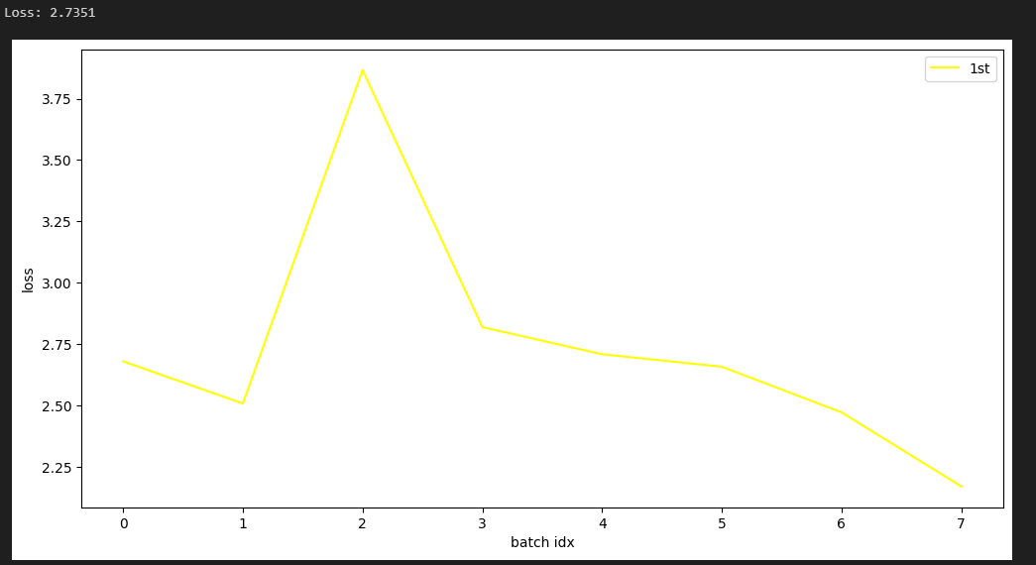
Initial Run (forward only, no training)

Slide 10
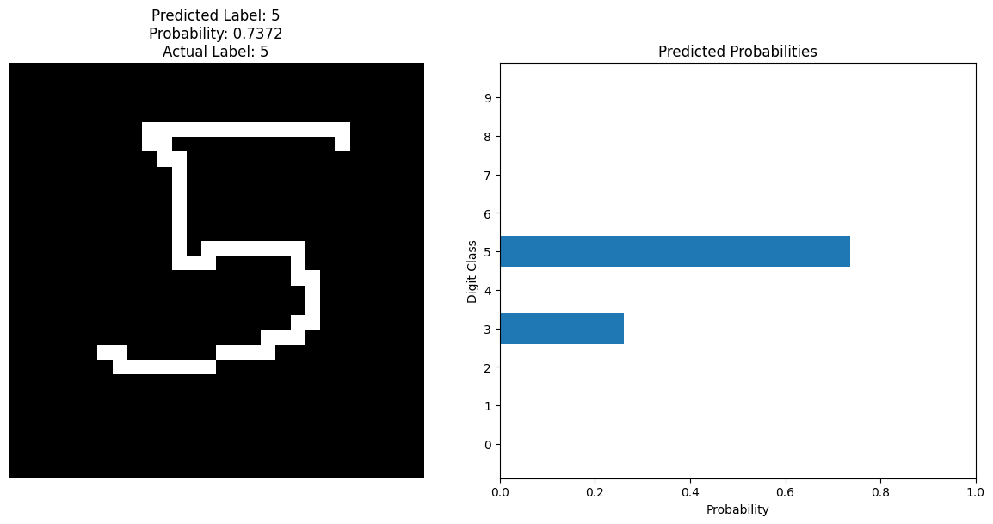
Initial Run continued

Slide 11
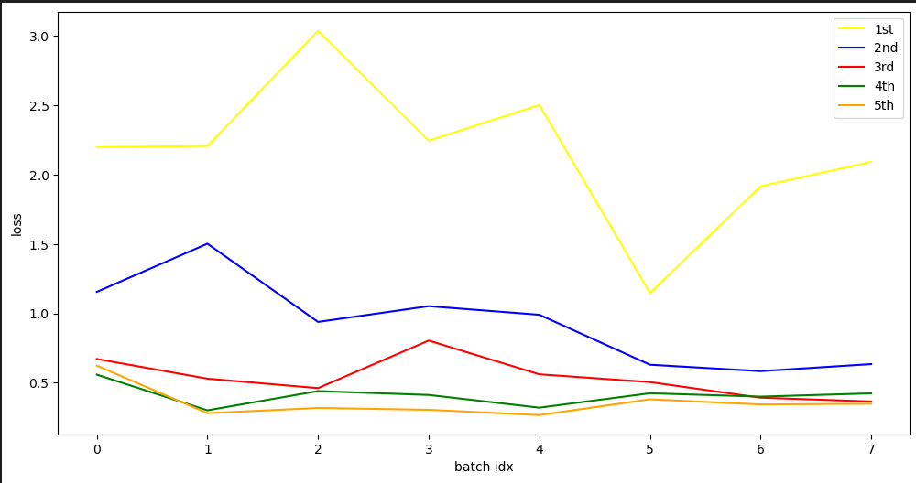
Train on class dataset

Slide 12
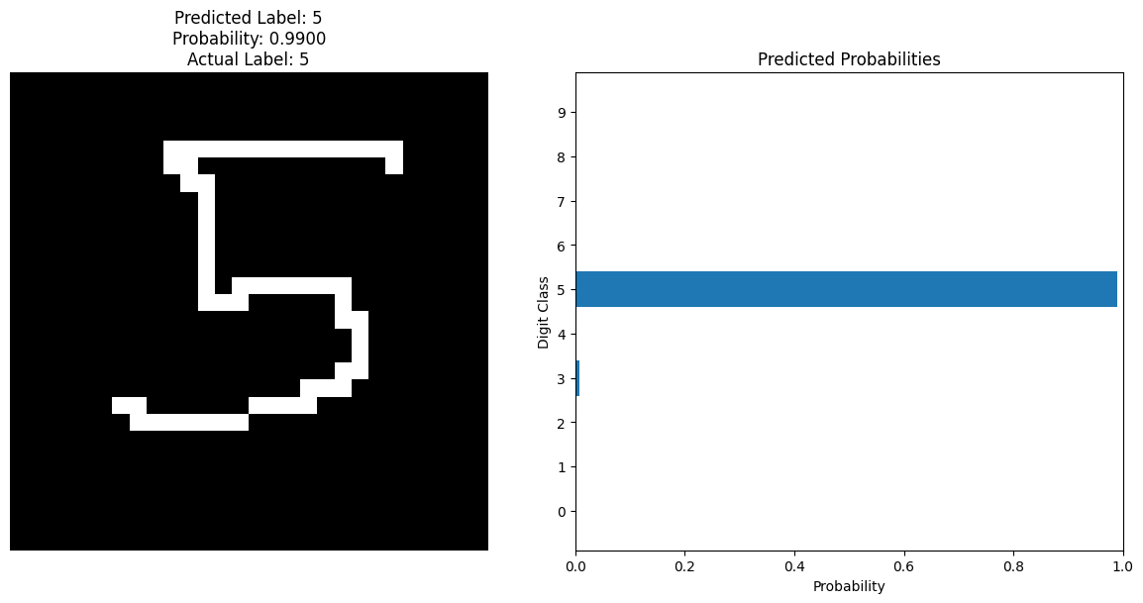
Trained Prediction

Slide 13
Conclusion
Initial model trained on MNIST dataset was surprisingly inaccurate in its predictions on the test dataset.
Further training on the test dataset improved accuracy to reasonable levels however.

Slide 14

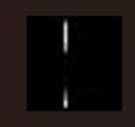
Peak handwriting

Slide 15
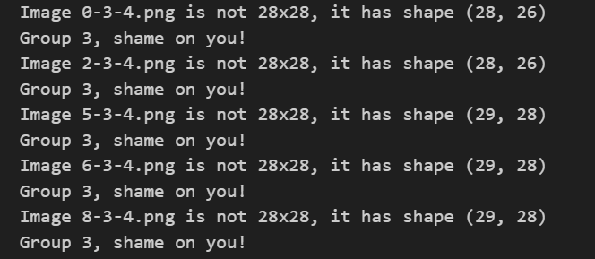
we see you group 3

